Slide 1
Which customers are unhappy?
Nadya Agrawal
March 2023

Slide 3
Overview & Business Problem
The Data
The Method
The Model
Findings
Recommendations
Next Steps

Slide 4
Overview & Business Problem
Our e-commerce company loses money when we lose customers.
How can we identify which customers will leave us before they do?
Through machine learning, we can determine the best predictors for churn.
Intuition: transactions and website usage will be the most important.

Slide 5
The Data
The data comes from the “Customer Churn” dataset, posted by Pawan Trivedi on Kaggle.
It contains data on membership, website use, transactions, and more.

Slide 6
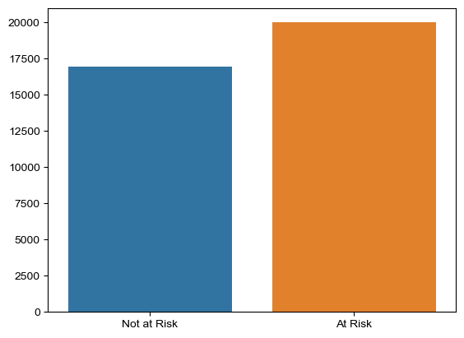
Data Split
Pretty even split between those at risk of churn and not

Slide 7
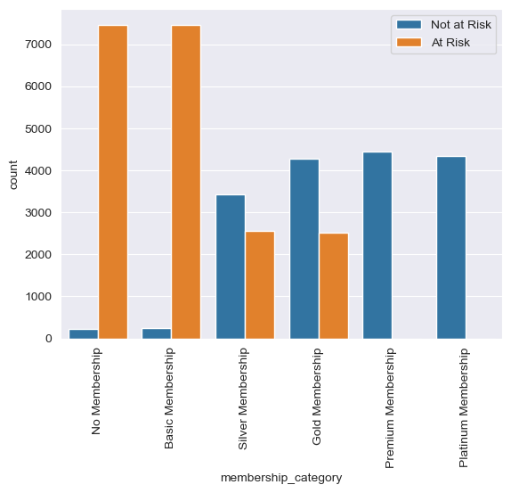
Membership
Six membership types
Most are in the “basic” or “no” membership categories, these are most are at risk of churn
The data shows everyone with a “platinum” or “premium” memberships are not at risk of churn

Slide 8
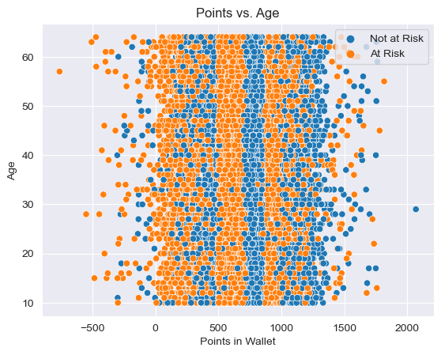
Wallet Points
The target seems almost sectioned when it comes to points

Slide 9
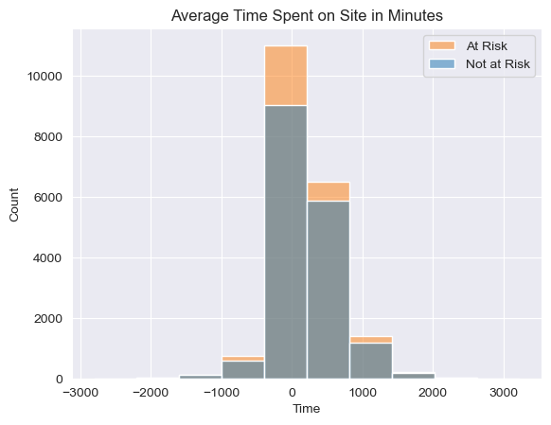
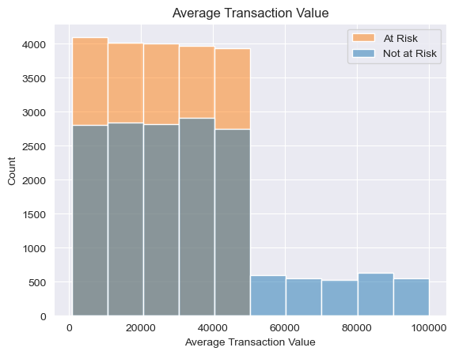
Time & Money
Thought time and money spent on the site would be best indicators, but doesn’t seem to be the case.

Slide 10
The Model
Ran a range of models, found XGBoost Classifier to be the best
Removed negative values since unreadable
Wanted to minimize false negatives

Slide 11
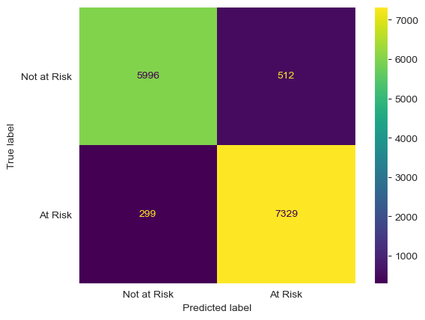
Confusion Matrix
XGBoost Classifier minimized false negatives the best compared to other models

Slide 12
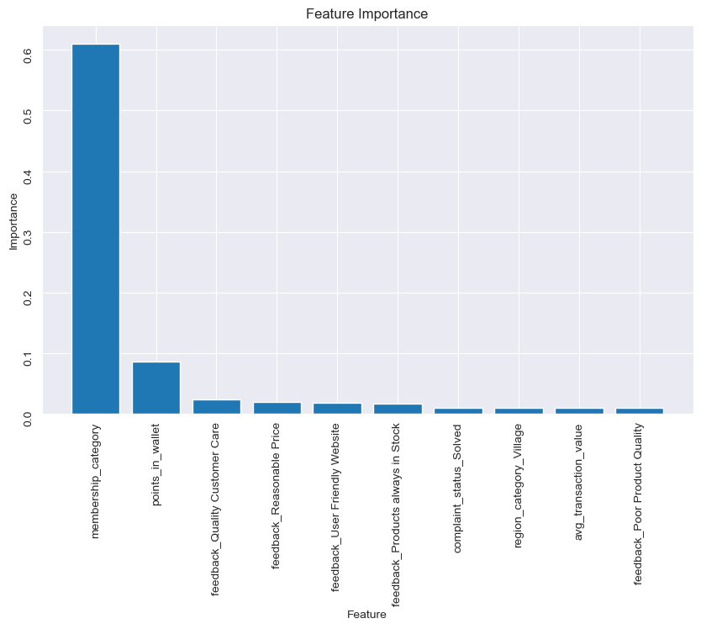
Features
Membership category is by far the most important feature in our model.
Followed by wallet points and if they’ve complained about customer care.

Slide 13
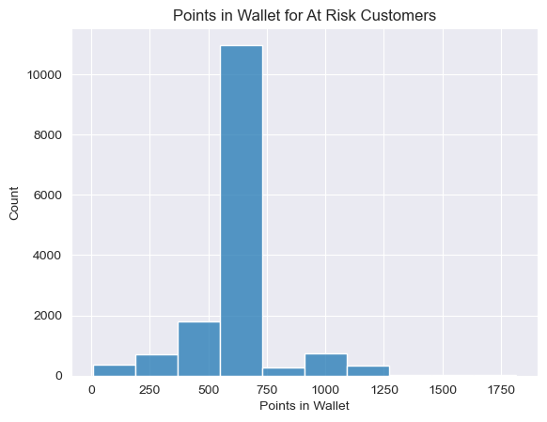
Wallet Points (again)
Wallet points is the second most important feature. Earlier we saw sectioning in the data.
Now we can look at the bins at risk customer fall into.
Most hold between 500-750 points.

Slide 14
Recommendations
Use XGBoost Classifier to predict churn risk
Focus marketing on customers that are in lower membership categories or do not hold a membership
Re-target customers who have between 500-750 points in wallet
Re-target customers who have given feedback on customer care quality
Notes:
98004 (bellevue), 98040 (mercer island), 98033 (kirkland)

Slide 15
Next Steps
Solve for overfit with additional recent, high-quality data.
Look at previous marketing to at-risk customers and determine whether re-targeting helps or hurts.

Slide 16

THANK YOU
Nadya Agrawal
/npagrawal
nadyaagrawal@gmail.com

